Slide 1
Dynamic Care Planning
IHE PCC
November 2015

Slide 2
The Problem
Sharing of patient data to support care coordination is static, not dynamic, and may lead to possible underuse, overuse and mis-use of healthcare services
Care plans have many different meanings to many different people
We need a useful way to consolidate these multiple plans and coordinate care
Notes:
This profile will use the term care plan for the framework created to solve the problems identified in the bulleted list below. We know that many bodies of work are ongoing related to this topic. Intentions are to build from that work and also to contribute.

Slide 3
The Solution
Coordination Framework:
HL7 DAM as the model framework
HL7 Care Coordination Service Functions
HL7 FHIR Resource and IHE Profiles to support CCS Capabilities
Care Plan Management
Care Team Membership
Care Team Communication
Notes:
We always will contrast Dynamic Care Planning, and the use of a Care Plan, with the creation and sharing of snapshot contents and CDA-based documents that contain information on some aspect of the care plan for a patient at a point in time.
Dynamic Care Planning can be broken down into a set of categorized capabilities, roughly translating to the set of actors and transactions we will need to profile.

Slide 4
The Vision
Develop a Dynamic Care Planning profile that will:
Support one overarching care plan for the patient
Meet the needs of many stakeholders
Provide a method to consolidate the many care plans that can be attached to a patient
Provide a framework for dynamic care planning
Notes:
(similar to the care management document in Australia and the IHE QRPH Care Management White Paper)
Q: the Anna Orlova, Lori F paper: IHE_QRPH_WP_Diabetes_Care_Mngt_PC_2010_06_04.pdf ?......we should acknowledge that we have seen this but not say it is similar;
same with care management document in Australia….similar?
Need to make clear: es, there absolutely is a place for documents with Care Plan contents, but we want to move to a dynamic care plan team and care plan data management capability
IHE QRPH Diabetes paper is about collection and sharing of specific data (e.g. diabetes diagnosis) to drive the use of clinical practice guidelines (CCS has a capability for this) and also to do public health reporting. It’s not about care provision – dynamic care planning supports care provision which include the use of clinical practice guidelines.
Patient Care did a comparison of various care planning efforts (including Australia) and came up with an aligned model that supports the DAM.

Slide 5
Use Case
Transitions in care
Example: Discharge from Acute Care to Post Acute Care
a) Provider to Provider, Team to Team, Provider to Team, …. transition
b) Support multi-disciplinary care coordination
Chronic Disease Management
a) Management and treatment of chronic health issues
b) Coordination of referrals and consultations
Notes:
Chronic Disease Management, and the representation of knowledge and guidelines are the focus of the QRPH white paper

Slide 6
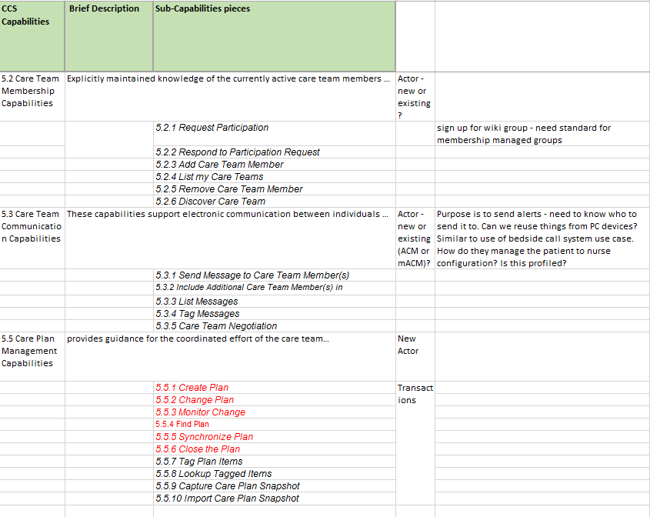
Notes:
Care Coordination Services Functional (categorical) groups that we believe are necessary and sufficient for profiling, along with the “transactions” in each group.
Our belief is that there are identifiable standards (or at least patterns) to handle Team Membership Capabilities (think: joining a google group), and also Team Communication Capabilities (IHE PCD ACM or ITI mACM …..(mobile) Alert Communication Management), and that the innovative work and patterns will be the profiling of actors and transactions for Care Plan Capabilities

Slide 7
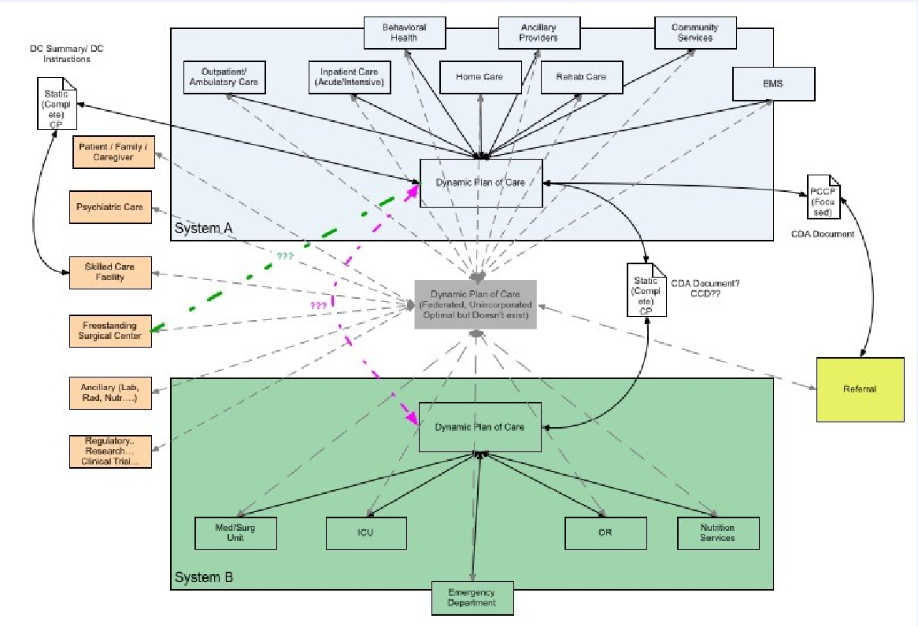
Technical Approach
Source: HL7 Domain Analysis Model
Notes:
Joint Care Plan Domain Analysis Model (JCPDAM).
Conceptual - According to HL7 policy, the “message models” are derived “later”.
Coordinating - While it “could” be used for physical consolidation, it is not a “takeover” of its distributed fragments.
Minimalist - Then let the Care Coordination Service (CCS) SOA project incorporate these classes as its care plan “parts” that are the focus of online reconciliation conferences.
The care plan topic is one of the rollouts of the Care Provision Domain Message Information Model (D-MIM). See http://wiki.hl7.org/index.php?title=D-MIM_Walkthrough_Care_Provision_Domain

Slide 8
Standards
HL7 CCS Functional Model
FHIR
IHE PIX and ATNA
?? HPD
??? Existing group membership standards
ACM or Google Groups or Wiki membership
Notes:
Need discussion on HPD and Existing group membership standards

Slide 9
Actors
New
Care Plan Manager
Possibly others depending on standards discovery
Existing
Content Creator
New Transactions
Content Consumer
New Transactions
Reconciliation Agent

Slide 10
Impact on Existing Profiles
It could inform the care plan structure of future profiles
It could be leveraged to any other profile that includes care plans, plans of care, treatment plans, or instructions.

Slide 11
Tasks to be Completed
Orientation: The IHE team should receive a presentation of the HL7 CP DAM and the CCS concepts for dynamic care planning.
Gather existing profiles: The IHE project team should gather its existing profiles that pertain to Care Planning
FHIR Resources: Examine and harmonize existing FHIR resources that can be used to support the applicable CCS capabilities

Slide 12
Risks
Scope Creep
Technical Risk
Some FHIR resources are still in flux (on going modifications)
Identifying and re-using appropriate technology
Redundancy - many groups are working on FHIR care plan profiling
Notes:
Technical Risk - Implementers need to be start building version 1 solutions in 2013.
2013???

Slide 13
Conclusion
This effort will produce a model for dynamic and shared “organizing care planning” which will facilitate consolidation of plans of care and treatment plans without violating the autonomies of the specialty care plans and planners.

Slide 14
Thank you

